Slide 1


OKLAHOMA HOUSING MARKETS
2013-2022

Slide 2

TABLE OF CONTENTS
INTRO
ABOUT THE DATA
QUESTIONS
ANSWERS
CONCLUSIONS
Q&A
01
02
03
04
05
06

Slide 3




Another idea, equally important
01
INTRO
TEAM
Scott Arterbury
Randy Esser
Ramkumar Jothis
Geoff Wilson
Ponca City, OK
Los Angeles, CA
India
Tulsa, OK

Slide 4
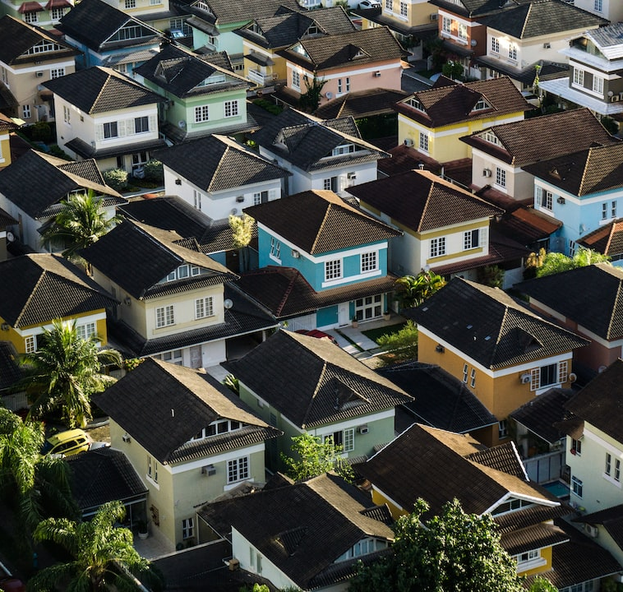
01
PROJECT GOALS
Where Are the Best Places to Own Real Estate in Oklahoma?
This project intends to answer critical investment questions regarding Oklahoma residential real estate. We will discover which locations offer the best return on investment (ROI) from both rental and sale perspectives.

Slide 5
02
ABOUT THE DATA
Source: NASDAQ & FRED
Download from data.nasdaq.com (Zillow residential property data)
FRED API (financial data)
Raw sources
Zillow home values, median sales price, and rental data
30 year mortgage rates
10 year U.S. Treasury yields
Gaps
Zillow data had significant gaps in available data for extreme rural areas
Rental data was only available from 2014 through mid-2022
Cleanup
Rows with missing data were dropped
Analysis focused on years & zones with full dataset
Analysis
Exploratory & statistical analysis

Slide 6
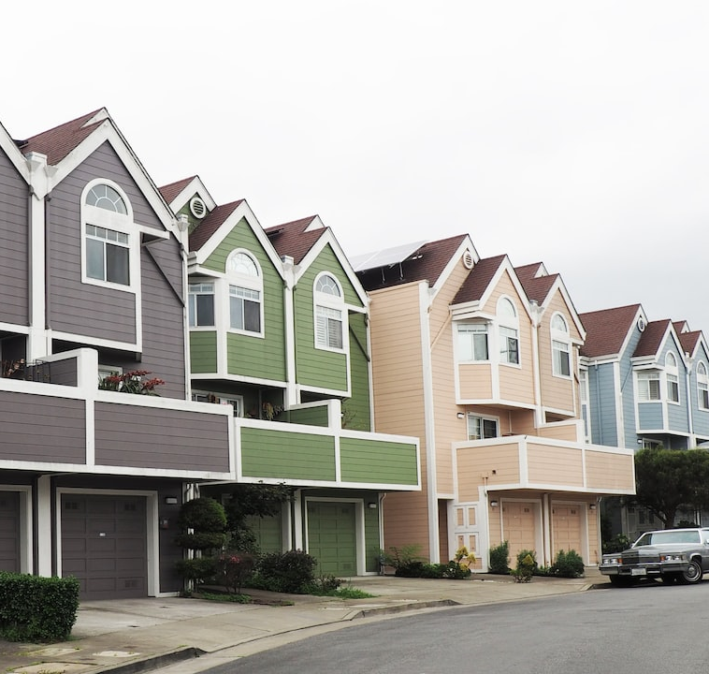
03
QUESTIONS
Where Are the Best Places to Own Real Estate in Oklahoma?
Which zip code gives the best home value ROI?
What is the impact of interest rate on median sales price?
Which zip code is the best place to own rental properties?

Slide 7
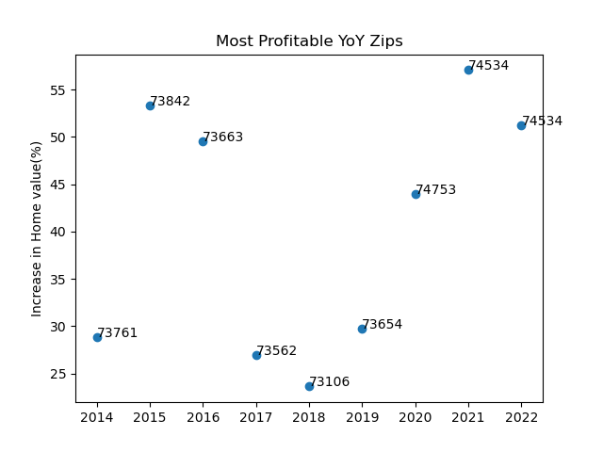
04
ANSWERS
Which zip code gives the best home value ROI?

Slide 8
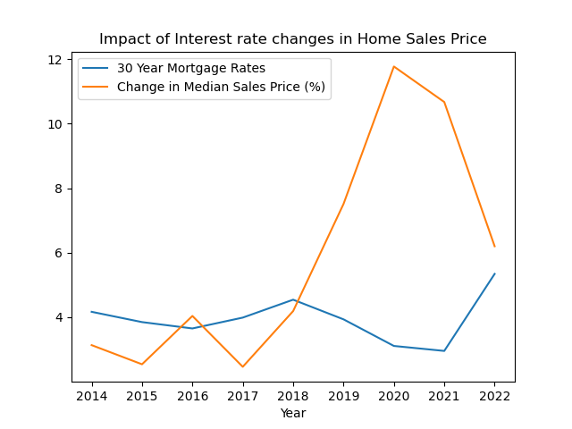
04
ANSWERS
What is the impact of interest rate changes on median sales price?

Slide 9
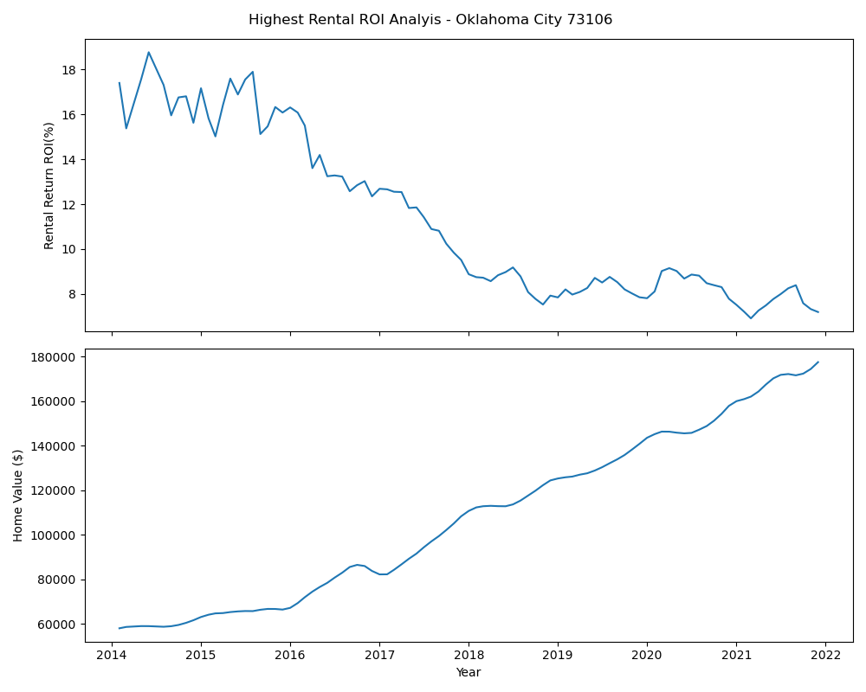
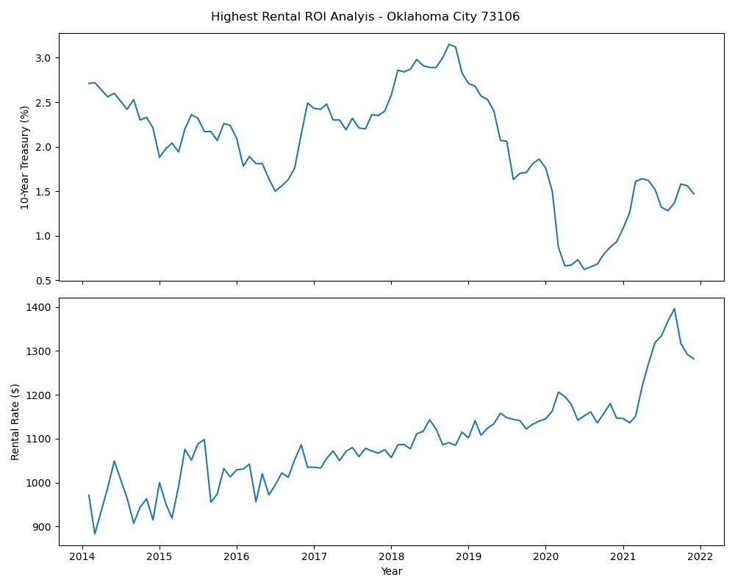
04
ANSWERS
Which zip code is the best place to own rental properties?

Slide 10
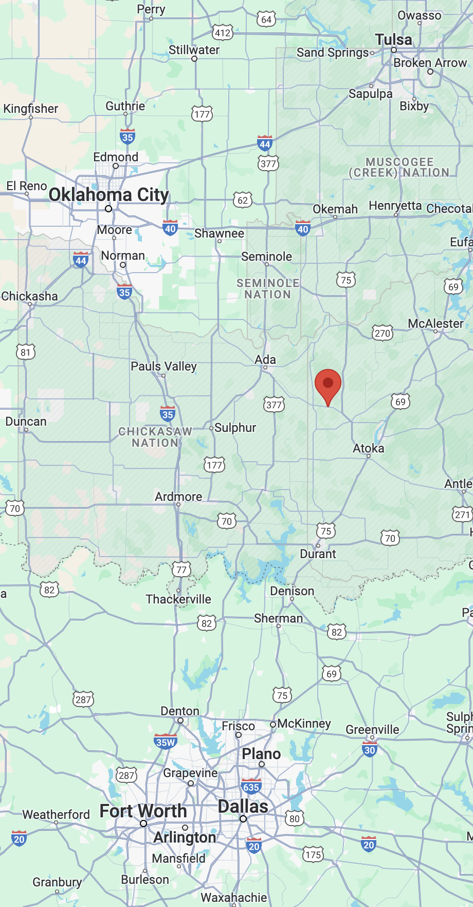
05
CONCLUSIONS
KEY INSIGHTS
74534 - Centrahoma (Southern Oklahoma) had the best home value ROI
Generally interests rates and median sales price are inversely correlated
73016 - Oklahoma City had the best rental ROI

Slide 11

06
Q&A

